Slide 1
JEFFERSON COUNTY PUBLIC SCHOOLS INVESTING IN OUR STUDENTS Presentation to JCTA Professional Representatives May 18, 2020

Slide 2
1. DOES MONEY MATTER? 2. HOW DOES MONEY MATTER? 3. CHALLENGES 4. REVENUE TRENDS 5. COMPARISONS TO OTHER DISTRICTS 6. COMMUNITY BENEFITS 7. RECOMMENDATION 8. DISCUSSION
OVERVIEW

Slide 3
1. DOES MONEY MATTER?

Slide 4
DOES MONEY MATTER?
“Studies have invariably found a positive, statistically significant relationship between student achievement gains and financial inputs” (Learning Policy Institute, 2017, p. 5).
“Results indicate a causal relationship between per-pupil spending and student outcomes” (National Bureau of Economic Research, 2014, p. 44).

Slide 5
DOES MONEY MATTER?
“Global resource variables such as [per-pupil expenditures] show strong and consistent relations with achievement” (Greenwald, Hedges, and Laine, 1996, pp. 384-385).

Slide 6
DOES MONEY MATTER?
“This consensus — that money does, indeed, matter — is supported by a growing body of high-quality empirical research” (Albert Shanker Institute, 2019, pp. 1-2).
“More equitable and adequate allocation of financial inputs to schooling provides a necessary underlying condition for improving the equity and adequacy of outcomes” (Learning Policy Institute, 2017, p. vii).

Slide 7
DOES MONEY MATTER?
“Additional funding appears to matter more for … students from low-income families” (Learning Policy Institute, 2017, p. 1).
“There is strong evidence of a causal effect of school spending on outcomes for children from poor families” (National Bureau of Economic Research, 2014, p. 38).

Slide 8
DOES MONEY MATTER?
“As concentrated poverty increases, the costs of achieving any given level of outcomes increase significantly” (Learning Policy Institute, 2017, p. 10).
“On average, the cost of educating a child with disabilities is twice the cost of educating a non-disabled student” (Alliance to Reclaim Our Schools, 2018, p. 5).

Slide 9
DOES MONEY MATTER?
“States with greater overall investment in education … have higher outcomes for low-income students” (Baker and Weber, 2016, p. 24).

Slide 10
DOES MONEY MATTER?
“Increases in per-pupil spending … led to significant increases in the likelihood of graduating from high school and educational attainment for poor children” (National Bureau of Economic Research, 2014, pp. 4-5).

Slide 11
DOES MONEY MATTER?
For children from low-income families, increasing per pupil spending by 10 percent in 12 school-age years increases:
Likelihood of graduating by 11.6 percentage points
Adult wages by 9.5 percent
Family income by 16.4 percent
Likelihood of being married and never divorced by 10 percentage points
(National Bureau of Economic Research, 2015, pp. 26-30)

Slide 12
DOES MONEY MATTER?
For children from low-income families, increasing per pupil spending by 20 percent in 12 school-age years:
Increases likelihood of graduating by 23 percentage points
Increases adult wages by 25 percent
Increases family income by 52.2 percent
Decreases adult poverty by 20 percentage points
(National Bureau of Economic Research, 2015, pp. i, 36, 38)

Slide 13
DOES MONEY MATTER?
“The magnitudes of these effects are sufficiently large to:
“completely eliminate the high school graduation gap between children from poor and non-poor families” (Baker and Weber, 2016, p. 5; see also National Bureau of Economic Research, 2014, p. 36; National Bureau of Economic Research, 2015, p. 26).
“completely eliminate the family income gap between children from low-income families and those from non-poor families” (National Bureau of Economic Research, 2014, p. 38).

Slide 14
DOES MONEY MATTER?
“Improved access to school resources can … significantly reduce the intergenerational transmission of poverty.”
(National Bureau of Economic Research, 2015, p. 39)

Slide 15
2. HOW DOES MONEY MATTER?

Slide 16
HOW DOES MONEY MATTER?
“Effective teachers are the most important school-based determinant of student educational performance” (Economic Policy Institute, 2019, p. 1).
“Investments in teacher quality … are particularly effective in raising achievement” (Learning Policy Institute, 2017, p. 5; see also Greenwald, Hedges, and Laine, 1996, pp. 384-385; National Bureau of Economic Research, 2015, p. 38).

Slide 17
HOW DOES MONEY MATTER?
“Research has illustrated the connection between staffing qualities and quantities and student outcomes” (Educational Testing Service, 2016, p. 3).
“Higher levels of staffing are also associated with reductions in achievement gaps” (Baker and Weber, 2016, p. 1).

Slide 18
HOW DOES MONEY MATTER?
More teachers per student means:
Teacher morale improves.
Student morale improves with more individual attention.
Relationships improve between principals and teachers.
(Wenglinsky, 1997, p. 225, see also p. 229)

Slide 19
HOW DOES MONEY MATTER?
“A series of studies … identified schools in which students of low socioeconomic status evince high levels of achievement. … Such schools display a series of relatively uniform characteristics … associated with high levels of achievement among low SES students” (Wenglinsky, 1997, p. 222).
high teacher morale
good relationships between teachers and principals
positive social environment
(Wenglinsky, 1997, p. 225, see also p. 229)

Slide 20
HOW DOES MONEY MATTER?
“The key resource that affects the social environment of the school is the number of teachers.”
“Teachers who are responsible for a large number of students tend to be demoralized because they have trouble developing relationships with all their students.”
(Wenglinsky, 1997, p. 225, see also p. 229)

Slide 21
HOW DOES MONEY MATTER?
“Fewer students per counselor … [has] also been found to improve student outcomes” (National Bureau of Economic Research, 2015, pp. 38-39).
“[Funding] increases … to hire more guidance counselors and social workers are consistent with the large, positive effects for those from low-income families” (National Bureau of Economic Research, 2014, p. 42; 2015, pp. 37-38).

Slide 22
HOW DOES MONEY MATTER?
“Per-pupil expenditures for instruction and the administration of school districts are associated with achievement” (Wenglinsky, 1997, p. 221).
“Fewer students per administrator … have also been found to improve student outcomes” (National Bureau of Economic Research, 2015, pp. 38-39).

Slide 23
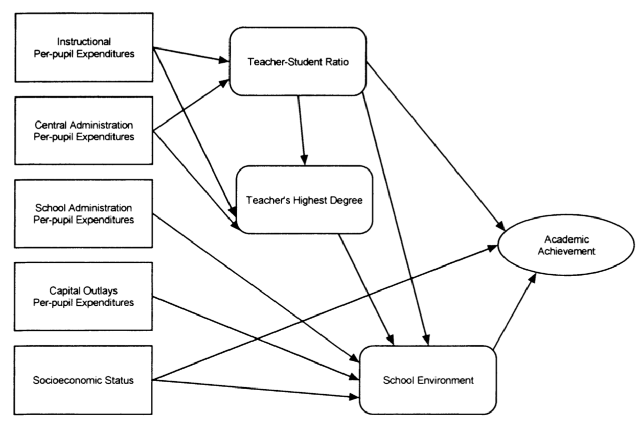
HOW DOES MONEY MATTER?
(Wenglinsky, 1997, p. 225)

Slide 24
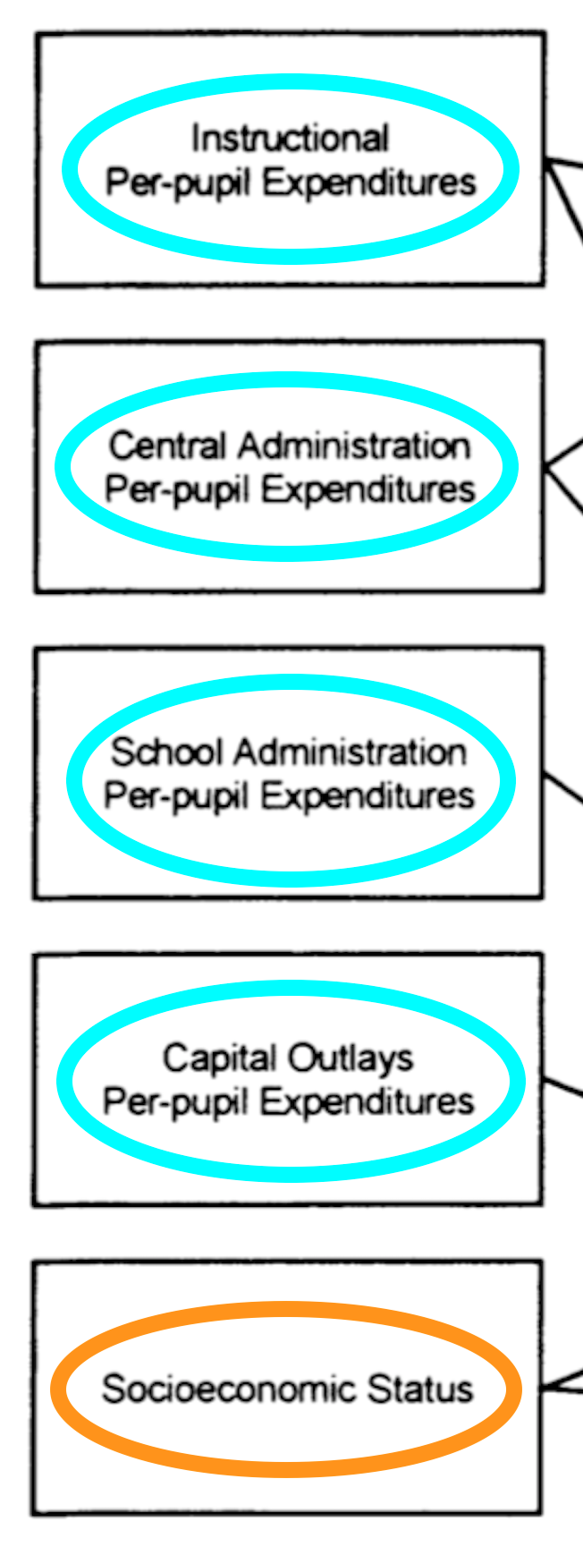
HOW DOES MONEY MATTER?
(Wenglinsky, 1997, p. 225)

Slide 25
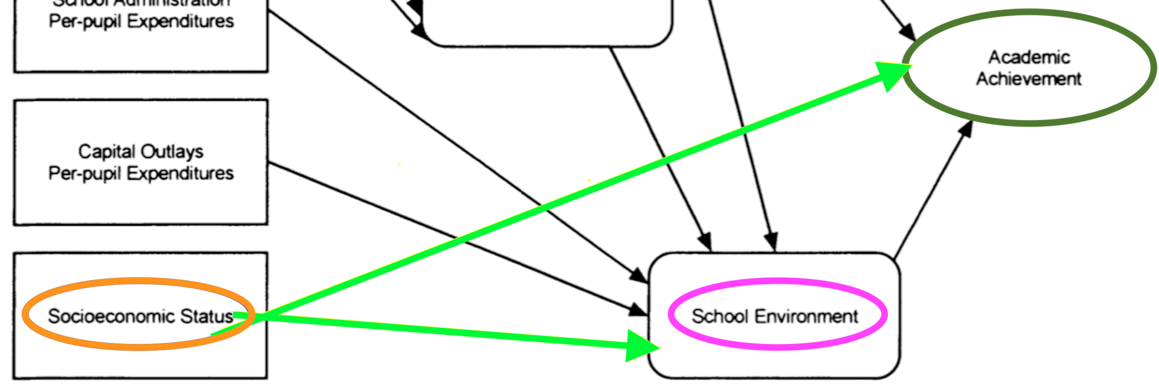
HOW DOES MONEY MATTER?
(Wenglinsky, 1997, p. 225)

Slide 26
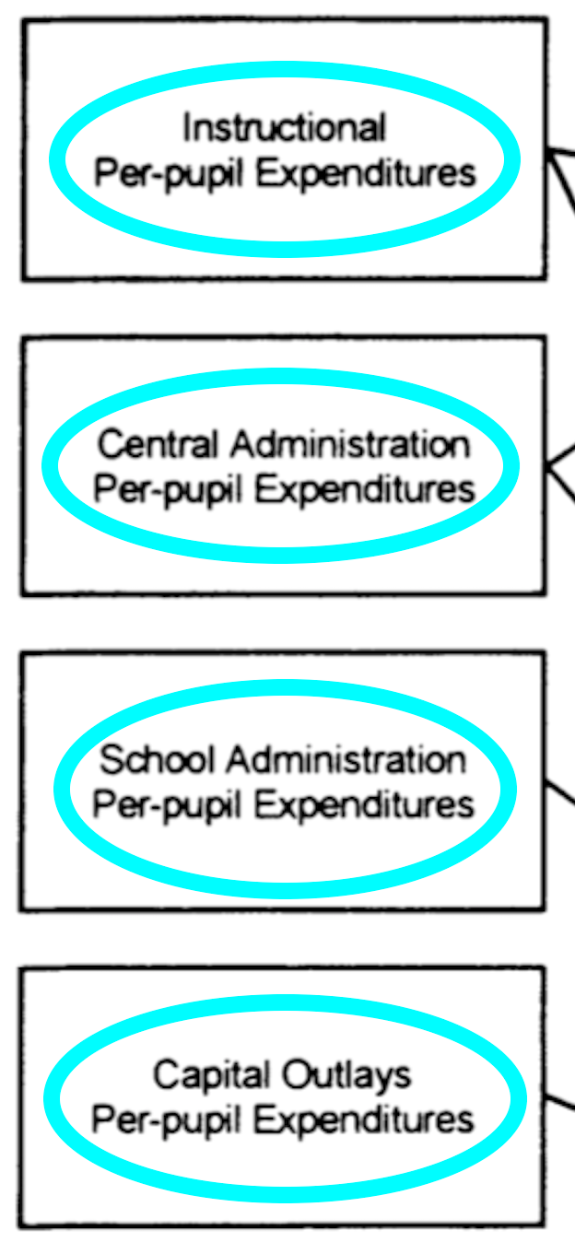
HOW DOES MONEY MATTER?
(Wenglinsky, 1997, p. 225)

Slide 27
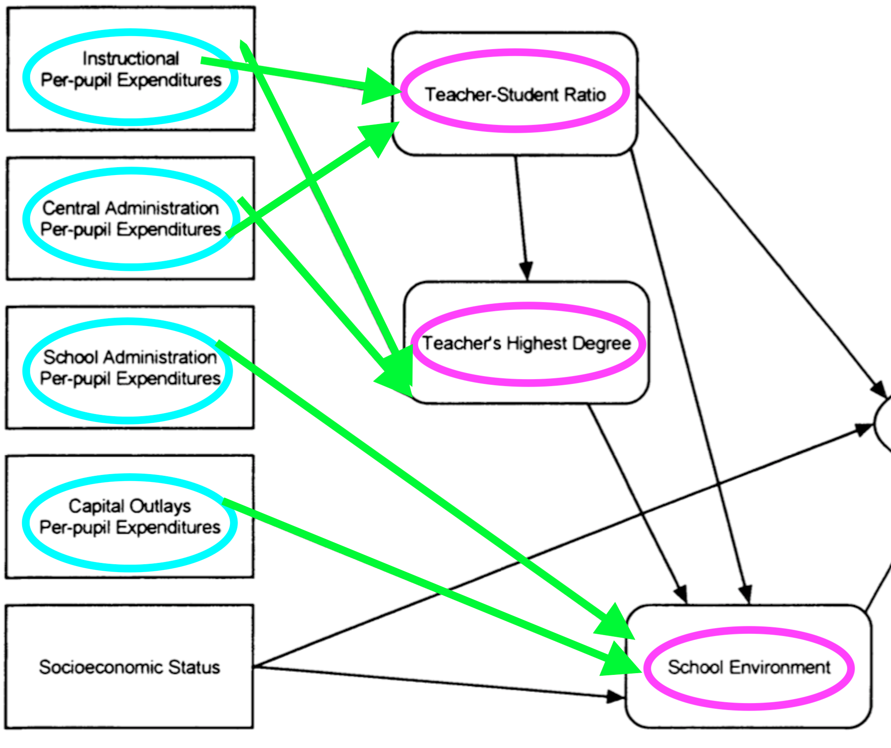
HOW DOES MONEY MATTER?
(Wenglinsky, 1997, p. 225)

Slide 28
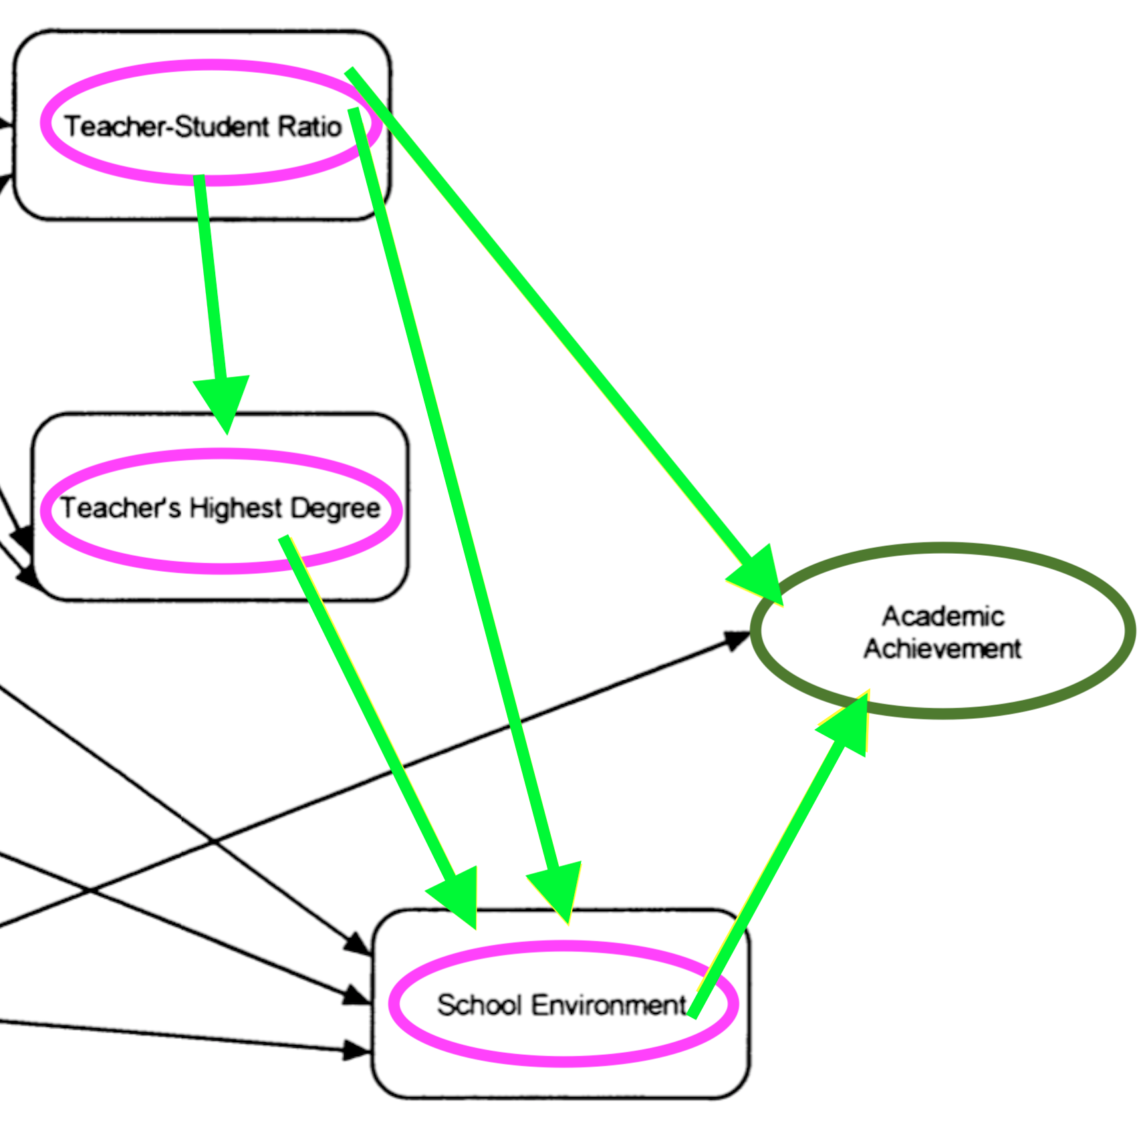
HOW DOES MONEY MATTER?
(Wenglinsky, 1997, p. 225)

Slide 29
HOW DOES MONEY MATTER?
“A significant body of research points to the effectiveness of class-size reduction for improving student outcomes and reducing gaps.”
“The effects of class size reduction on achievement … are most pronounced for students of color and those in schools serving concentrations of students in poverty.”
(Learning Policy Institute, 2017, p. 11)

Slide 30
HOW DOES MONEY MATTER?
“Cohesive school environments are positively related to students’ achievement above and beyond students’ social backgrounds.”
“Class size is, in turn, positively related to school social environment, with schools having more cohesive social environments when they have smaller classes.”
(Wenglinsky, 1997, p. 221)

Slide 31
HOW DOES MONEY MATTER?
“Higher teacher salaries lead to increases in the quality of applicants … and increases in student outcomes” (Educational Testing Service, 2016, p. 5).
“Teacher wages affect teacher quality” (Learning Policy Institute, 2017, p. 3).

Slide 32
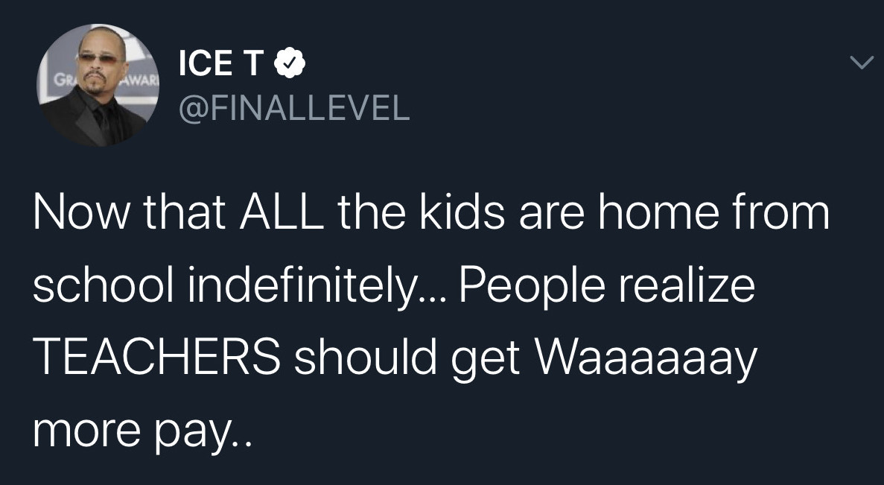
HOW DOES MONEY MATTER?

Slide 33
HOW DOES MONEY MATTER?
“[Funding] increases … to hire more teachers and/or increase teacher salary … are consistent with the large, positive effects for those from low-income families” (National Bureau of Economic Research, 2014, p. 42; see also 2015, pp. 37-38).
“Increases in teacher wages have been found in several studies to be associated with increased student achievement” (Learning Policy Institute, 2017, p. 12; see also Loeb and Page, 2000, p. 395).

Slide 34
HOW DOES MONEY MATTER?
“High teacher turnover consumes economic resources. … Filling a vacancy costs $21,000 on average.”
(Economic Policy Institute, 2018, pp. 2-3)

Slide 35
HOW DOES MONEY MATTER?
“[We] expect … substantial increases in achievement if resources were targeted to selecting (or retaining) more educated or more experienced teachers” (Greenwald, Hedges, and Laine, 1996, p. 380; see also Loeb and Page, 2000, pp. 395, 406).

Slide 36
3. CHALLENGES

Slide 37
CHALLENGES
Teacher wage penalty: “the percent by which public school teachers are paid less in wages and compensation than other college-educated workers” (Economic Policy Institute, 2019b, p. 1).

Slide 38
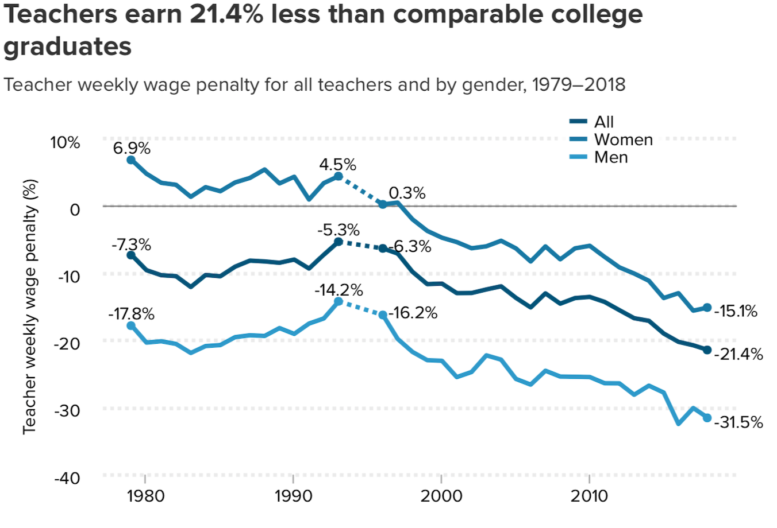
CHALLENGES
(Economic Policy Institute, 2019b, p. 11)

Slide 39
CHALLENGES
“Between 2004 … and 2018, weekly wages of other college graduates grew $119 (7.2 percent), while teacher weekly wages dropped $44 (3.6 percent)” (Economic Policy Institute, 2019b, p. 9).
“The teacher weekly wage penalty was 5.3 percent in 1993 … and reached a record 21.4 percent in 2018” (Economic Policy Institute, 2019b, p. 3).

Slide 40
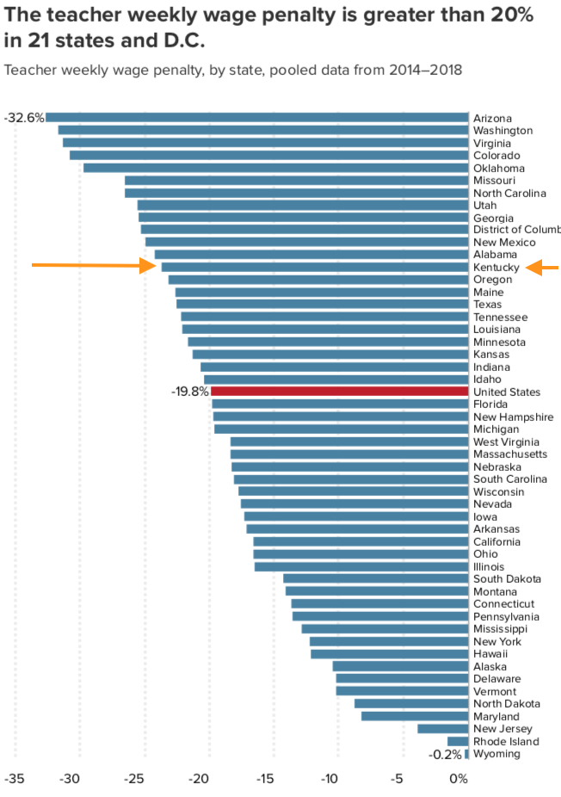
CHALLENGES
Wage penalty in Kentucky is significantly worse than the national average.
(Economic Policy Institute, 2019b, p. 14)

Slide 41
CHALLENGES
“The teacher shortage is real, large, and growing, and worse than we thought” (Economic Policy Institute, 2019a, p. 1).

Slide 42
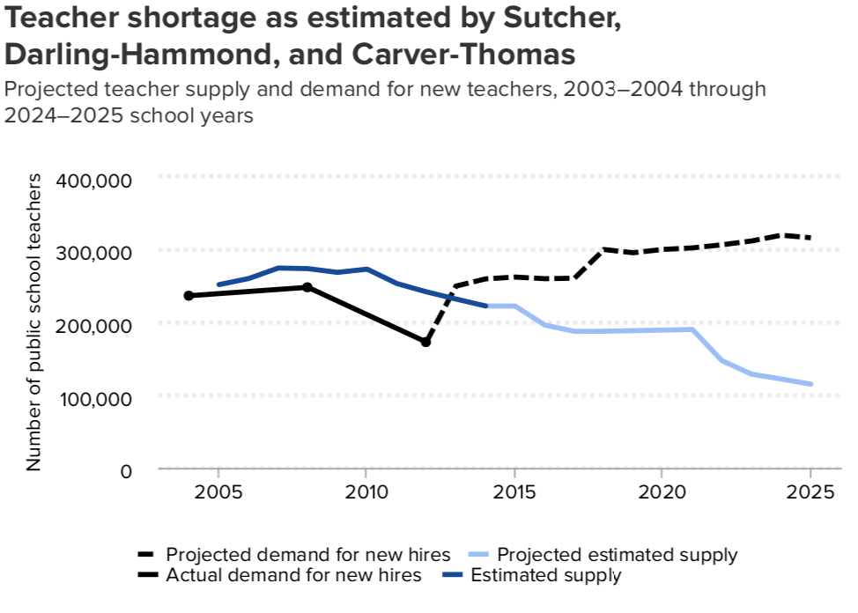
CHALLENGES
(Economic Policy Institute, 2019a, p. 3)

Slide 43
CHALLENGES
“Compensation is a necessary, major tool in addressing constant shortages” (Economic Policy Institute, 2019a, p. 2).
“Teachers’ overall wages and relative wages affect the quality of those who choose to enter the teaching profession — and whether they stay once they get in” (Learning Policy Institute, 2017, p. 11).

Slide 44
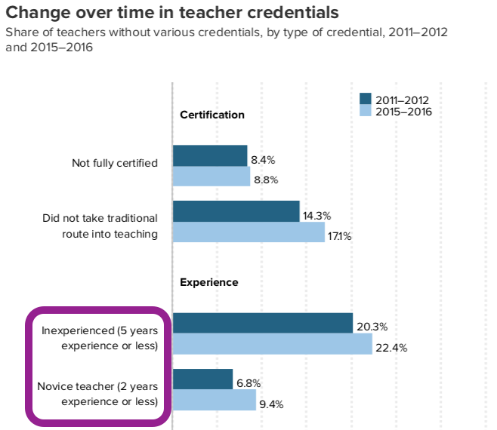
CHALLENGES
(Economic Policy Institute, 2019a, p. 5)

Slide 45
4. REVENUE TRENDS

Slide 46
REVENUE TRENDS
“Kentucky … sets aside 15.8 percent less per public school student than it did in 2008” (Barton, 2017, paras. 1-2).

Slide 47
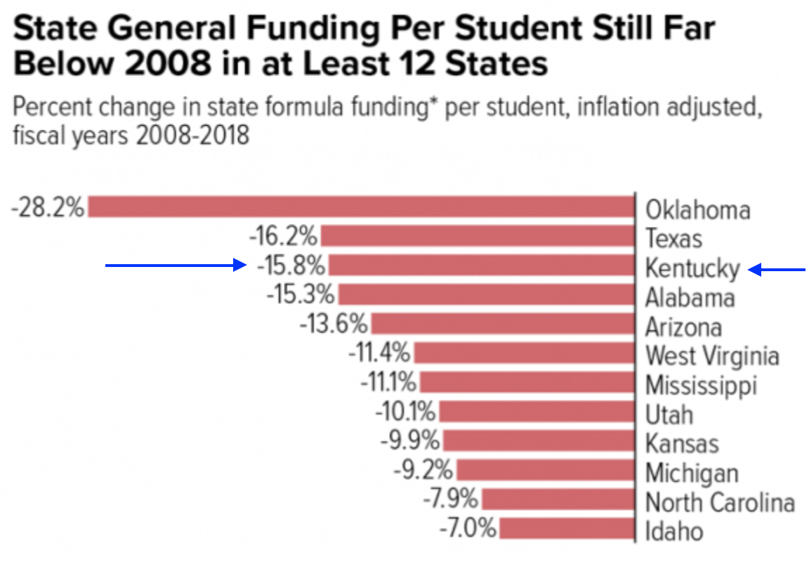
REVENUE TRENDS
(Center on Budget and Policy Priorities, 2017)

Slide 48
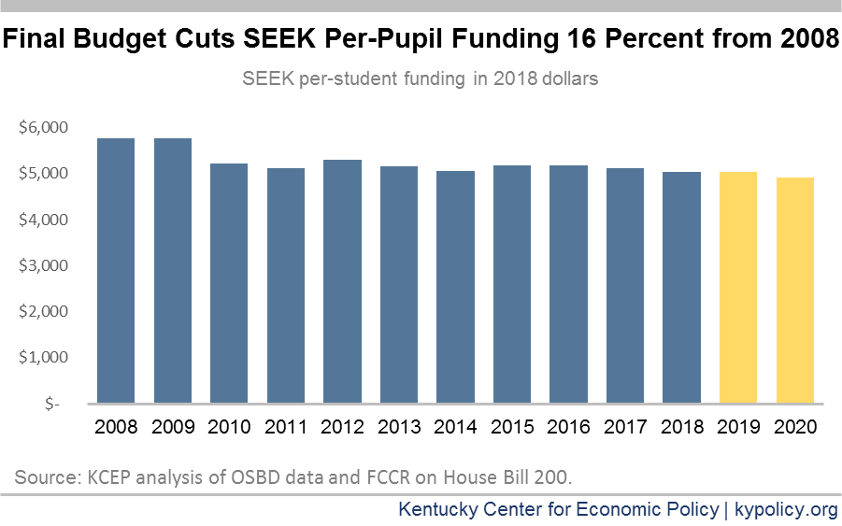
REVENUE TRENDS
(Spalding, 2018, fig. 1)

Slide 49
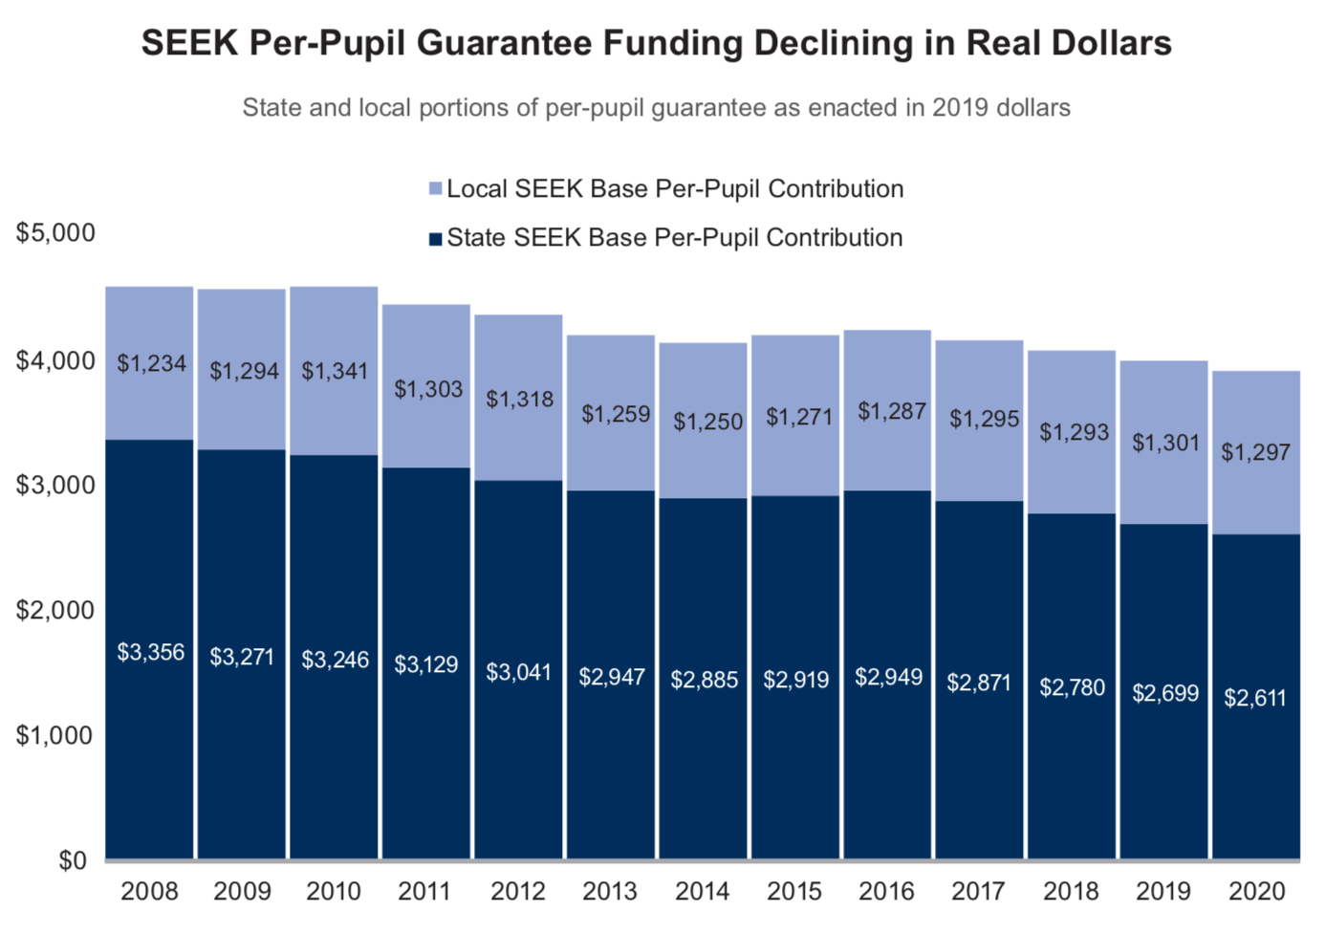
REVENUE TRENDS
(Kentucky Center for Economic Policy, 2020, p. 3)

Slide 50
REVENUE TRENDS
“The state portion declined … by $122 between 2008 and 2020, while the local portion grew by $300 [over 23 percent]” (Kentucky Center for Economic Policy, 2020, p. 3).

Slide 51
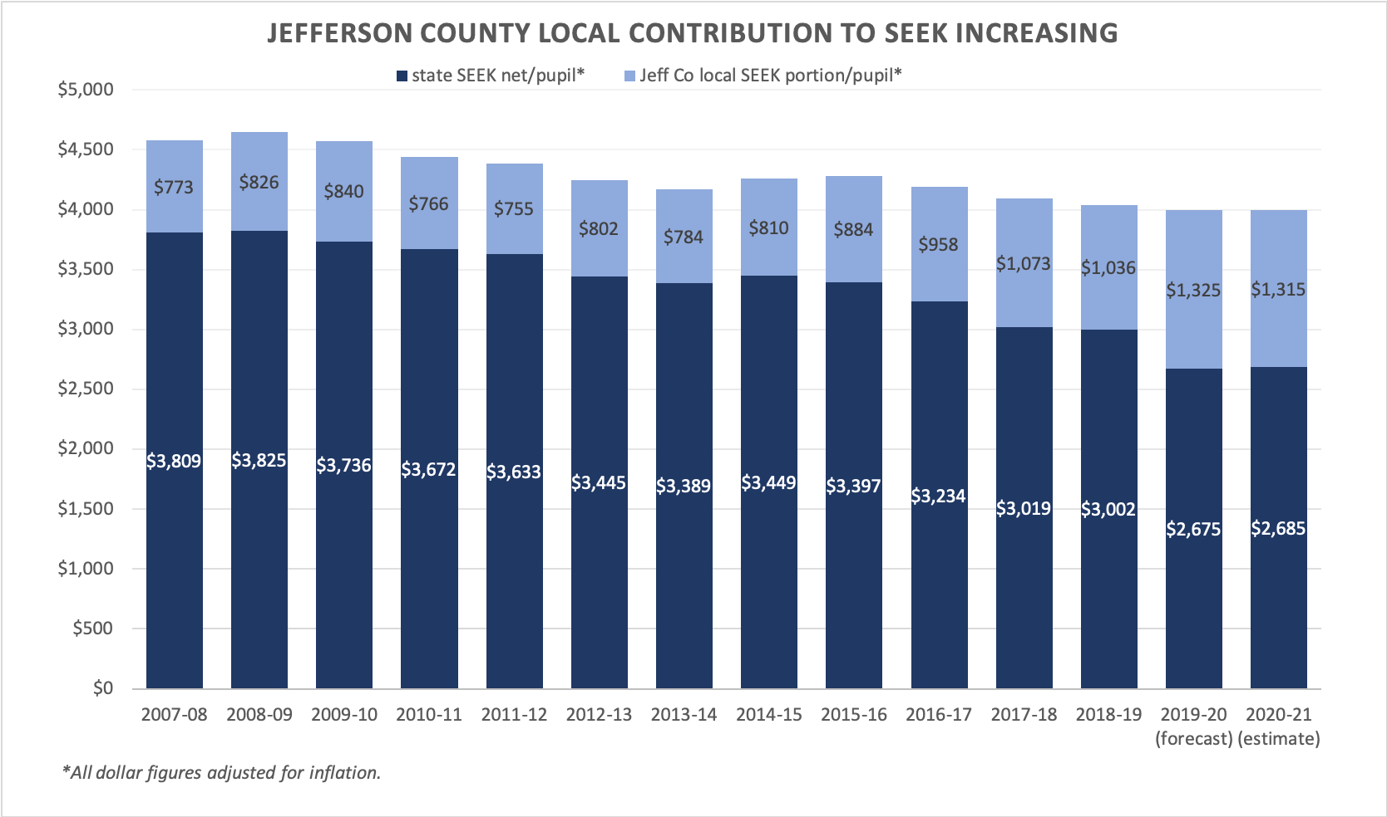
REVENUE TRENDS
(Source: JCPS analysis of Kentucky Department of Education data)

Slide 52
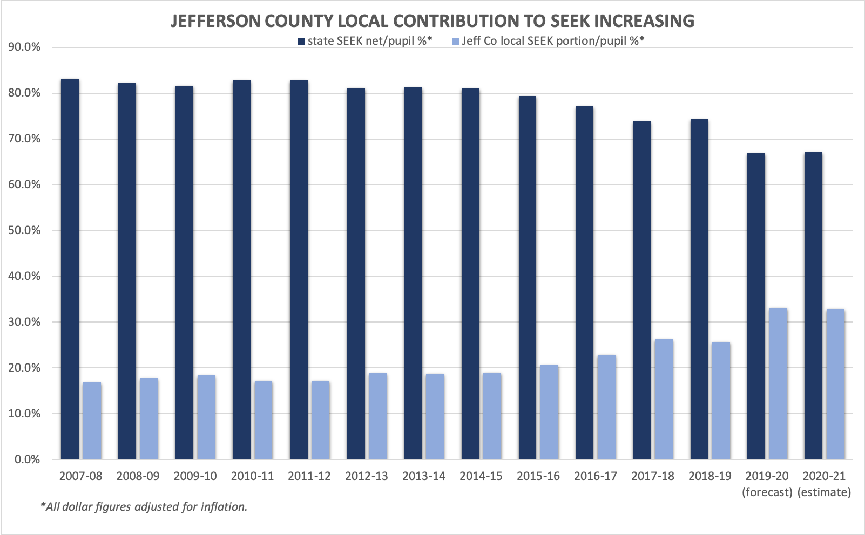
REVENUE TRENDS
(Source: JCPS analysis of Kentucky Department of Education data)

Slide 53
REVENUE TRENDS
One-third of “state” funds for JCPS students are actually made up of local money disguised as state funding.

Slide 54
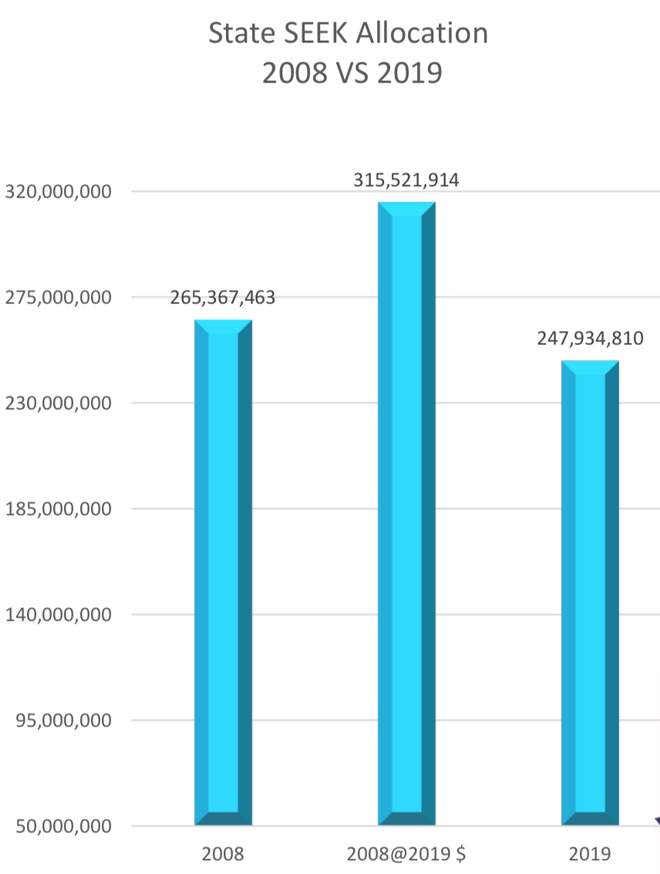
REVENUE TRENDS
SEEK allocation to JCPS down $67,587,104 since 2008.
(Source: JCPS analysis of Kentucky Department of Education data)

Slide 55
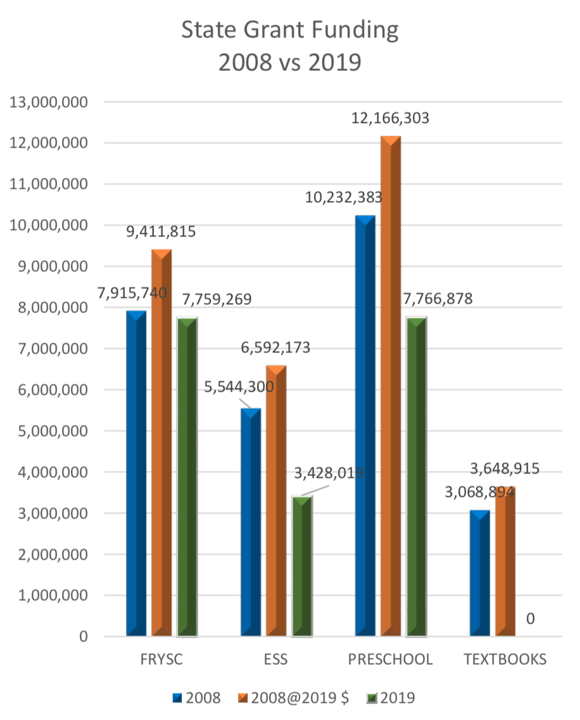
REVENUE TRENDS
State Grant Funding Cuts
FRYSC: 18% cut
ESS: 48% decrease
Preschool: 36% cut
Textbooks: 100% cut
PD: 100% cut
(Source: JCPS analysis of Kentucky Department of Education data)

Slide 56
REVENUE TRENDS
“[Kentucky received] an ‘F’ in Education Week’s Quality Counts report for education spending.”
“Funding cuts in recent years … have had a significant negative impact on kids and classrooms.”
(Kentucky Center for Economic Policy, 2020, p. 2)

Slide 57
REVENUE TRENDS
Federal Funding:
Title I — additional support for schools with high concentrations of poverty.
IDEA (Individuals with Disabilities Act) — funding for children with disabilities (in JCPS, this is under ECE, Exceptional Child Education).
(Kentucky Center for Economic Policy, 2020, p. 2)

Slide 58
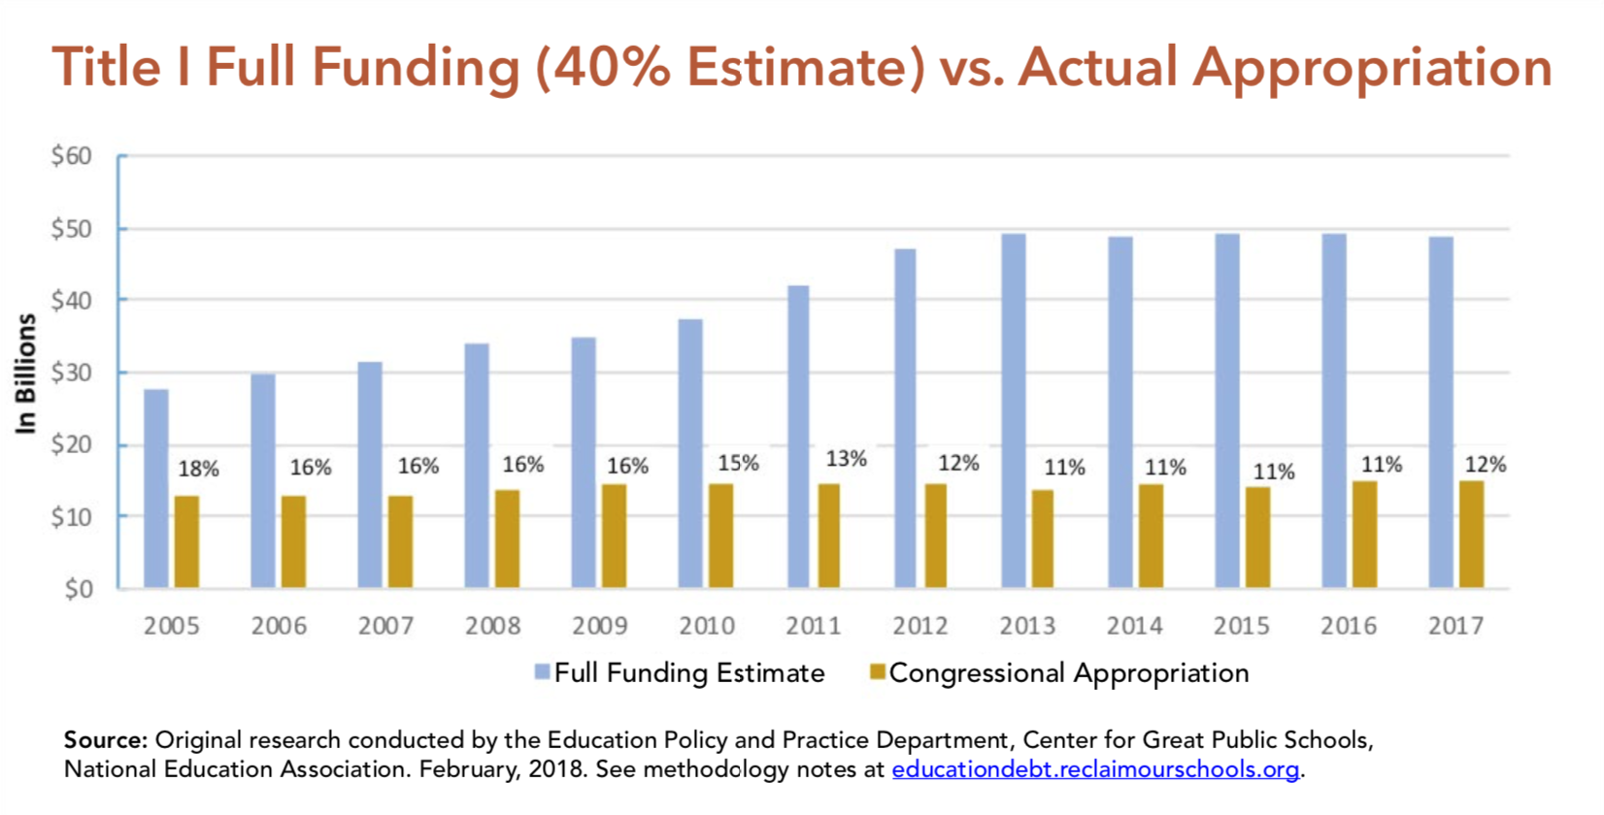
REVENUE TRENDS
(Alliance to Reclaim Our Schools, 2018, p. 4)

Slide 59
REVENUE TRENDS
“Over the past dozen years, Congressional appropriations for Title I have averaged less than half the promised funding” (Alliance to Reclaim Our Schools, 2018, pp. 4-5).

Slide 60
REVENUE TRENDS
“If Title I was fully funded by Congress, the nation’s high-poverty schools could provide:
“health and mental health services for every student, including dental and vision services; and
“a full-time nurse in every Title I school; and
“a full-time librarian for every Title I school; and
“a full-time additional counselor for every Title I school, or
“a full-time teaching assistant in every Title I classroom.”
(Alliance to Reclaim Our Schools, 2018, p. 5)

Slide 61
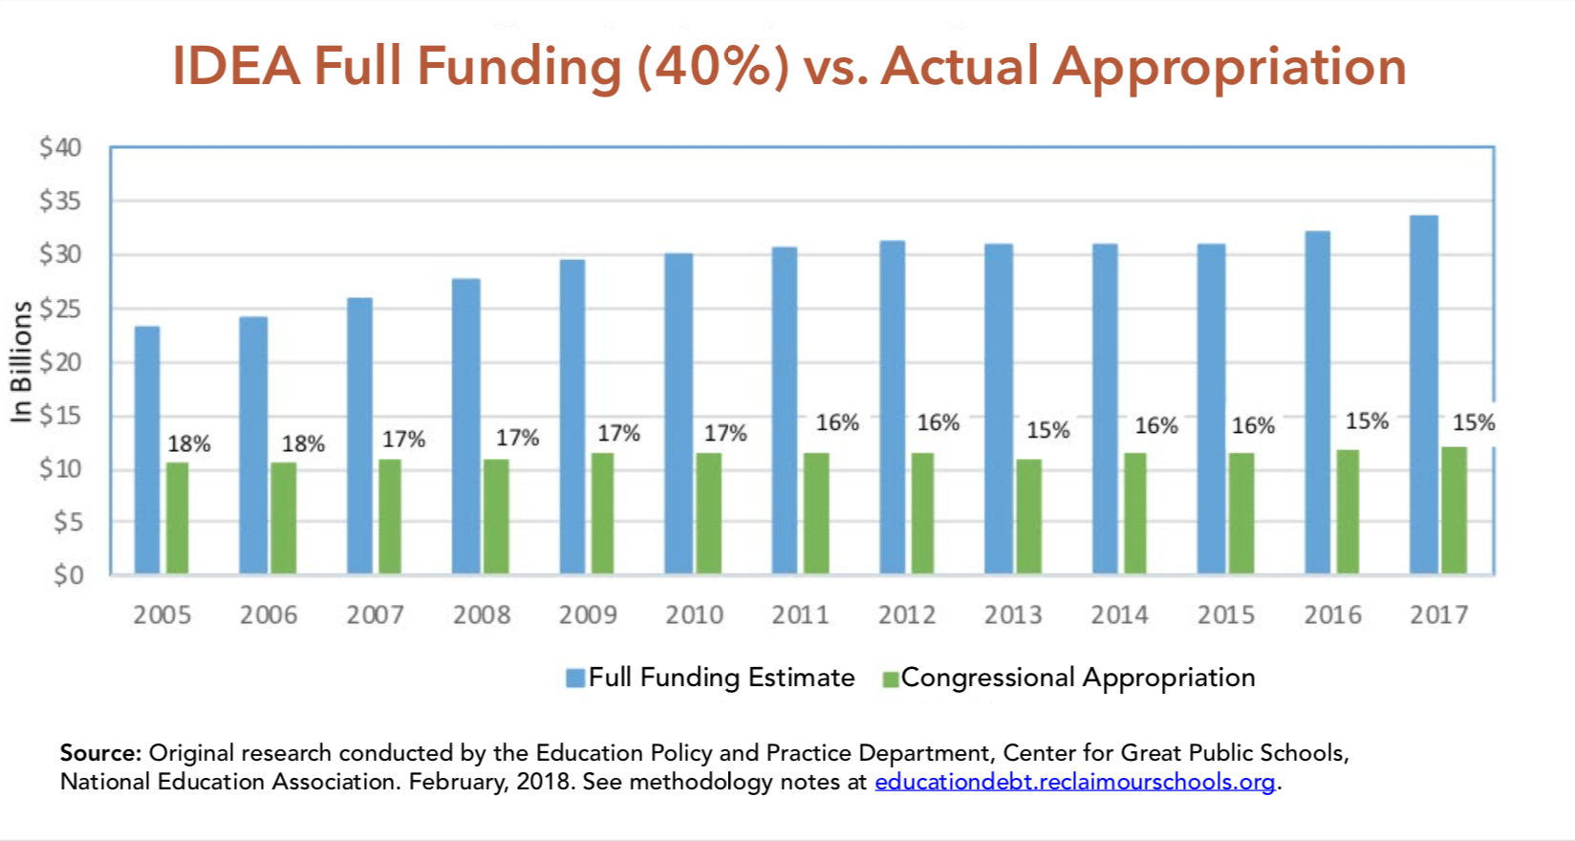
REVENUE TRENDS
(Alliance to Reclaim Our Schools, 2018, p. 5)

Slide 62
REVENUE TRENDS
Federal underpayment of IDEA since 2005 is $2,637 per year for every special needs student in the country, 53 percent of whom are students of color” (Alliance to Reclaim Our Schools, 2018, p. 6).

Slide 63
REVENUE TRENDS
“Federal funding of IDEA has never approached the promised 40 percent mark.”
“State and local governments must not only contribute their share, but also cover the unfunded federal contribution.”
(Alliance to Reclaim Our Schools, 2018, p. 6)

Slide 64
REVENUE TRENDS
Between 2005 and 2017, the federal government shortchanged Kentucky $10.2 billion in Title I and IDEA (Alliance to Reclaim Our Schools, 2018, pp. 18-20).

Slide 65
REVENUE TRENDS
State statute requires that Kentucky fund transportation at 100% .
The 2018 state budget only funded transportation at 60% (later adjusted to 66% due to funds transfer).
(Kentucky Center for Economic Policy, 2020, p. 4)

Slide 66
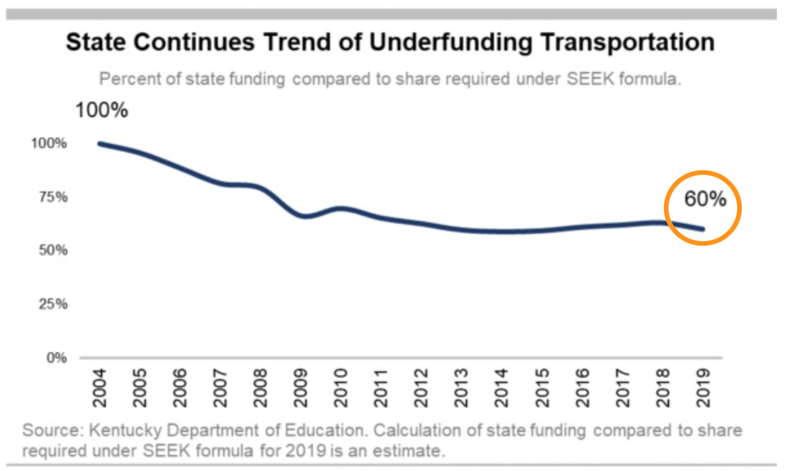
REVENUE TRENDS
(Spalding, 2019, fig. 3)

Slide 67
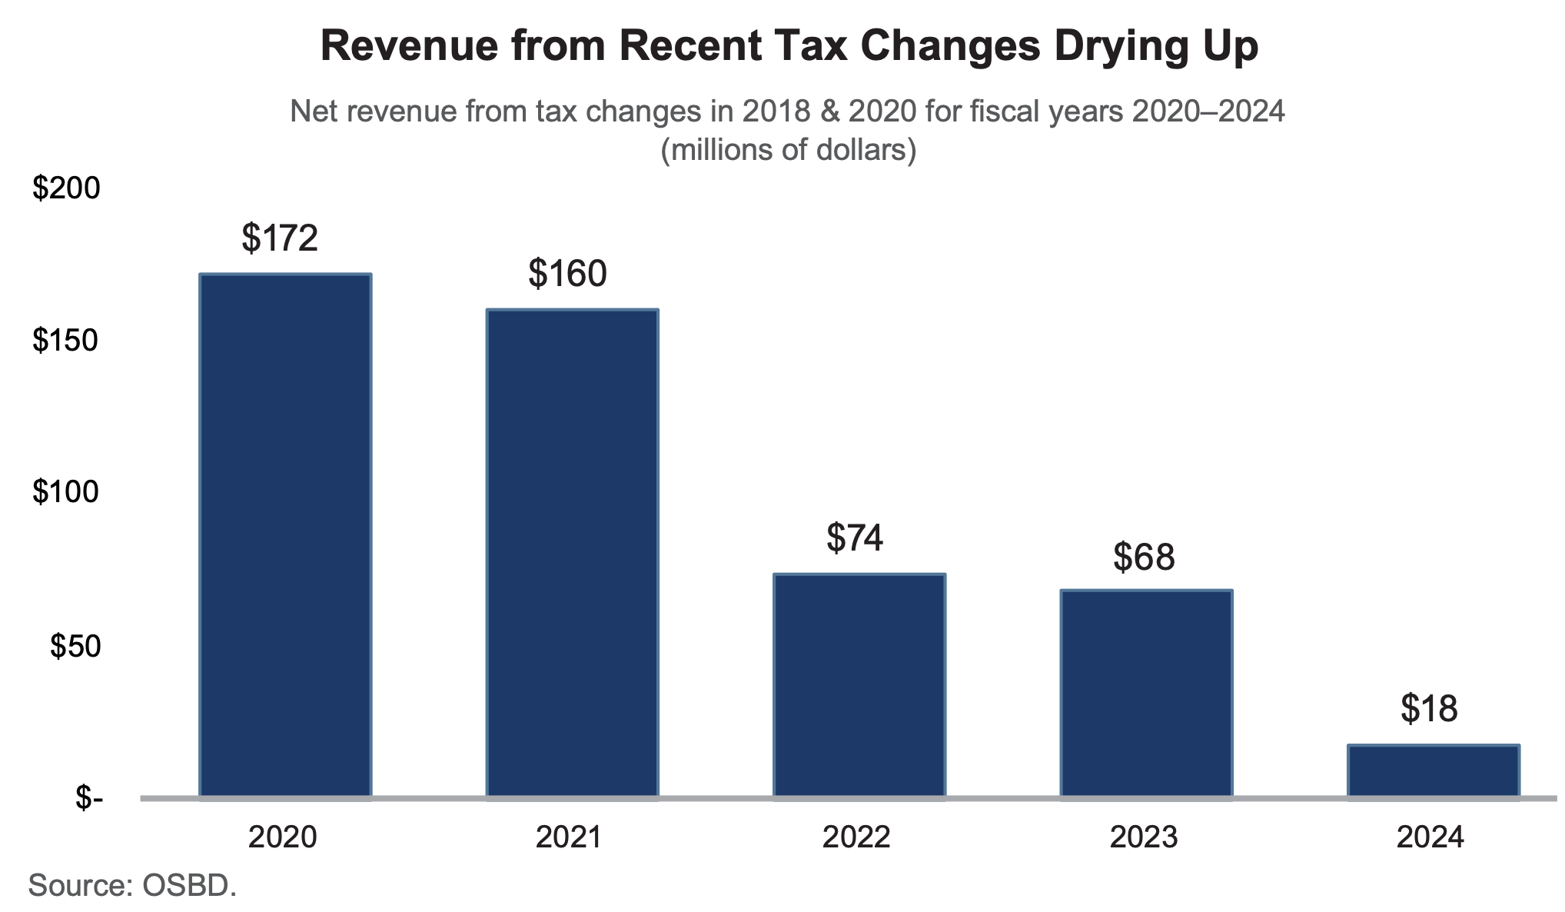
REVENUE TRENDS
(Kentucky Center for Economic Policy, 2020, p. 43)

Slide 68
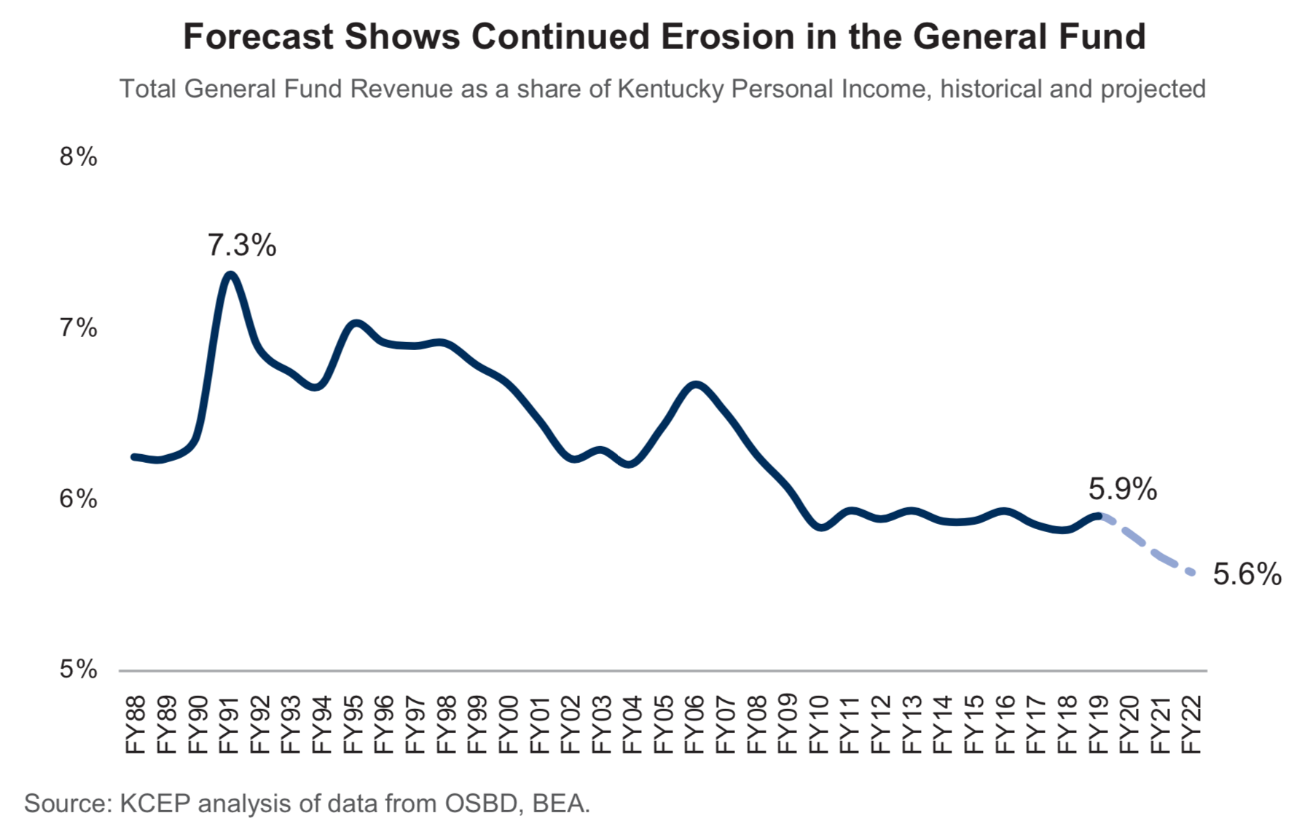
REVENUE TRENDS
(Kentucky Center for Economic Policy, 2020, p. 39)

Slide 69
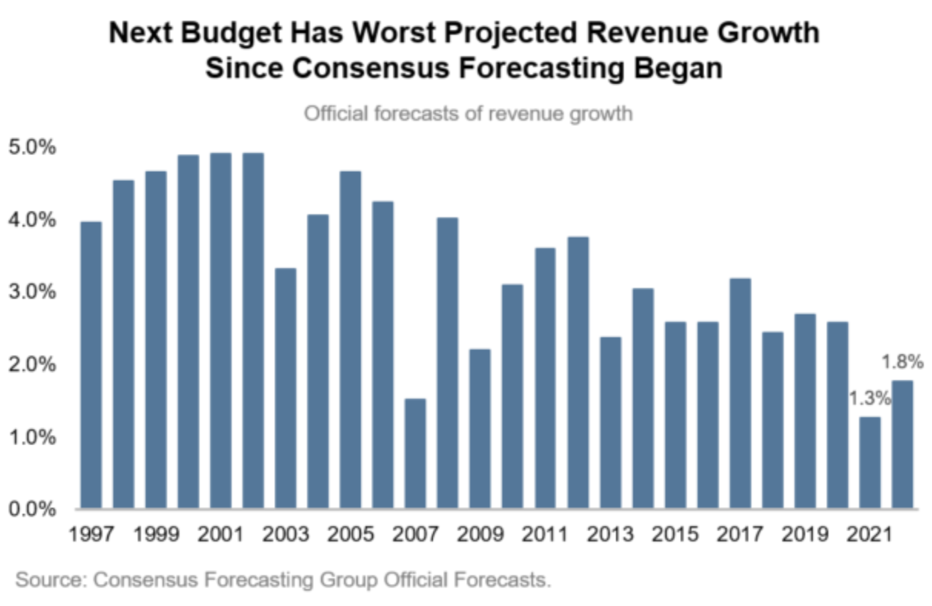
REVENUE TRENDS
The growth estimate for the next two years is the weakest on record.
(Bailey, 2020, para. 3, fig. 1)

Slide 70
REVENUE TRENDS
“The situation may be so dire that without tax reform to generate additional state tax revenues, we will likely face substantial cuts to base SEEK funding and all other education programs.”
(Kentucky Schools Boards Association,, 2017, paras. 7-8)

Slide 71
REVENUE TRENDS
(Center on Budget and Policy Priorities, 2017)

Slide 72
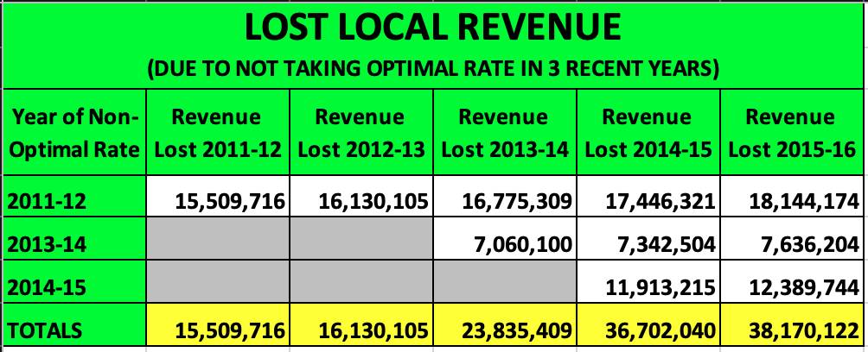
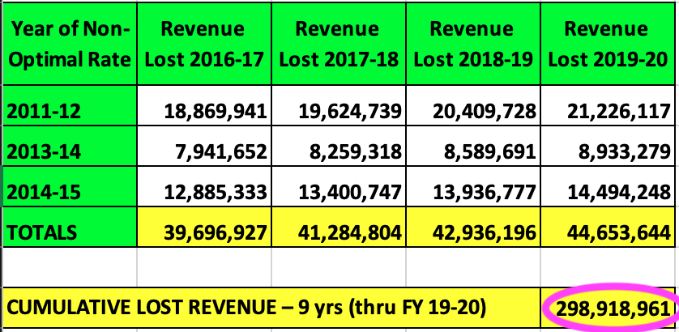
REVENUE TRENDS
(Source: JCPS analysis)

Slide 73
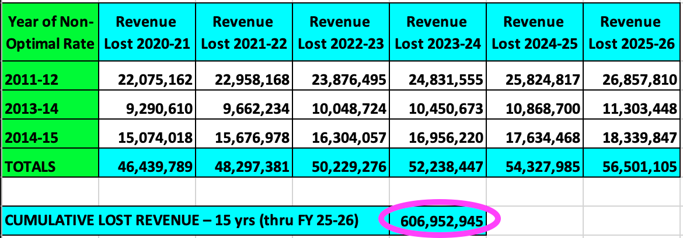
REVENUE TRENDS
(Source: JCPS analysis)

Slide 74
5. COMPARISONS TO OTHER DISTRICTS

Slide 75
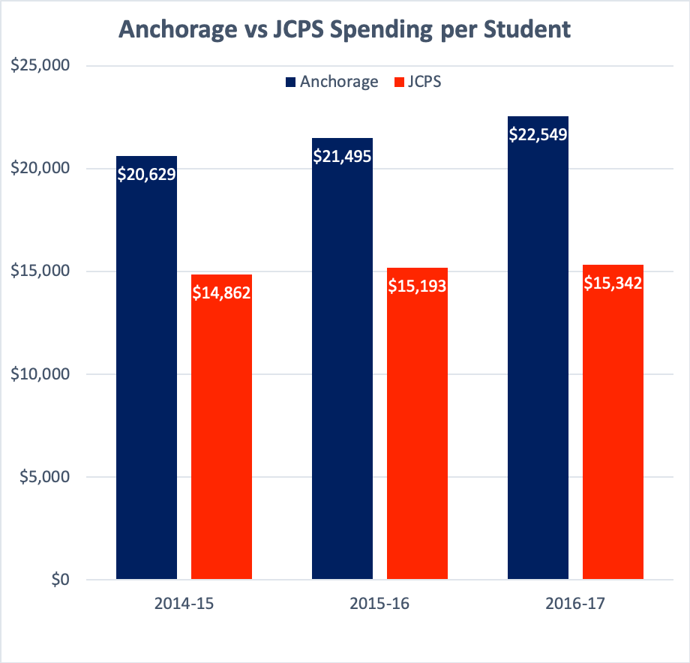
COMPARISONS TO OTHER DISTRICTS
In 2017, Anchorage spent over $7,000 more on every student.
(Office of Educational Accountability, 2018, pp. 19, 185)

Slide 76
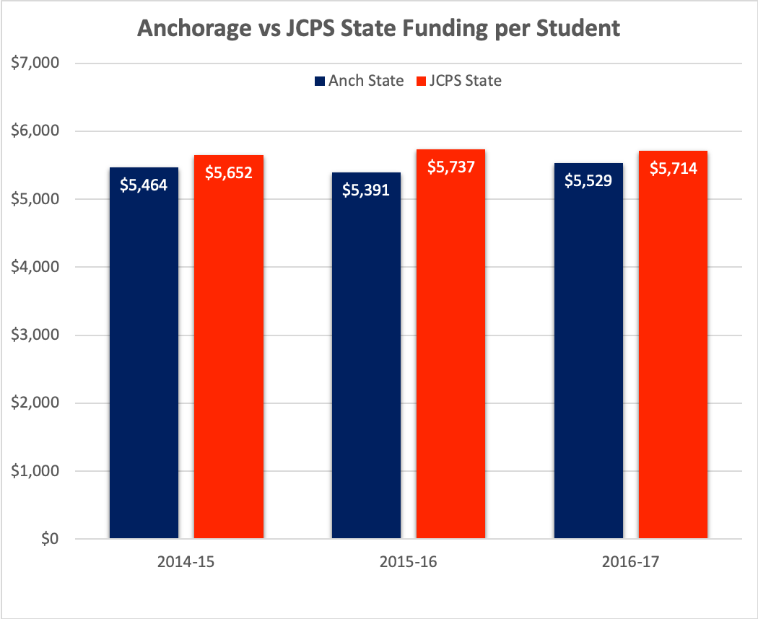
COMPARISONS TO OTHER DISTRICTS
Anchorage students receive about the same amount of state funding as JCPS students.
(Office of Educational Accountability, 2018, pp. 19, 185)

Slide 77
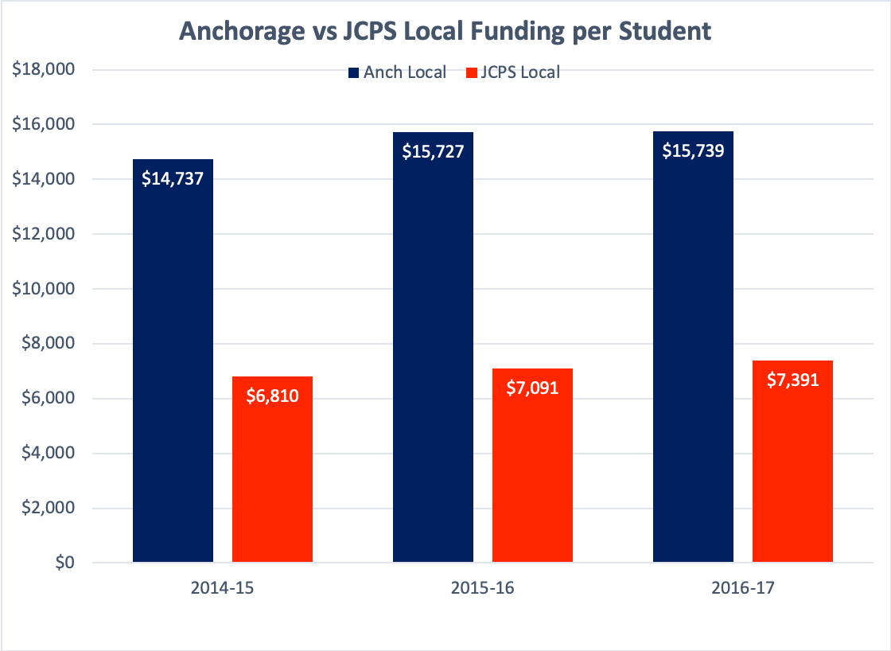
COMPARISONS TO OTHER DISTRICTS
Anchorage students receive over twice as much local funding, about $8,500 more for every student.
(Office of Educational Accountability, 2018, pp. 19, 185)

Slide 78
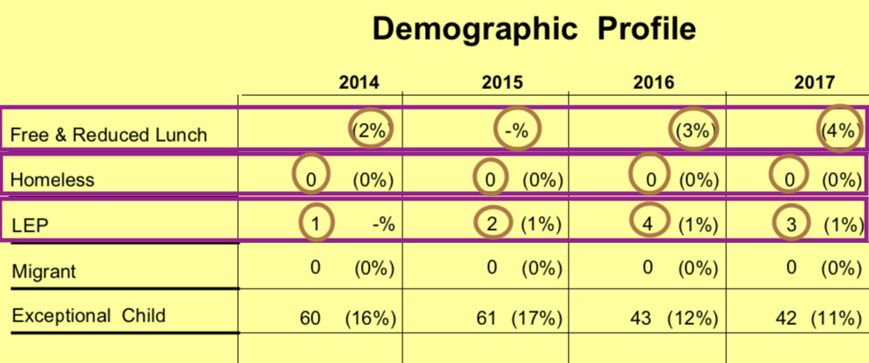
COMPARISONS TO OTHER DISTRICTS
Anchorage has no homeless students, almost no students in poverty, and almost no English learners.
(Office of Educational Accountability, 2018, pp. 18, 184)

Slide 79
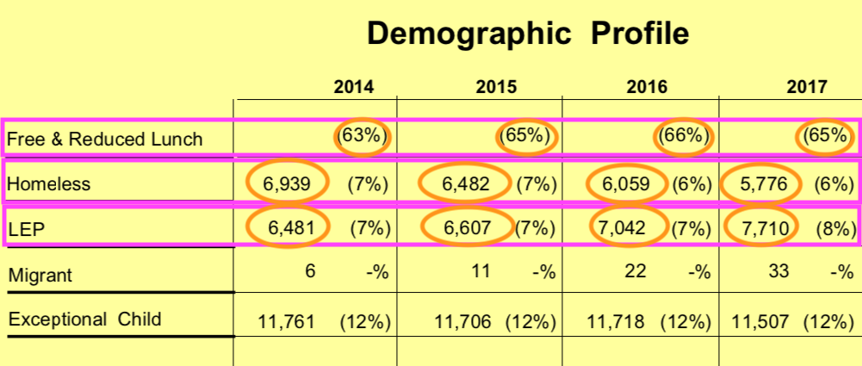
COMPARISONS TO OTHER DISTRICTS
JCPS (right) has over 65,000 low-income students, almost 7,000 homeless students, and almost 6,500 English learners.
(Office of Educational Accountability, 2018, pp. 18, 184)

Slide 80
COMPARISONS TO OTHER DISTRICTS
(Kentucky Center for Economic Policy, 2019, slide 65)

Slide 81
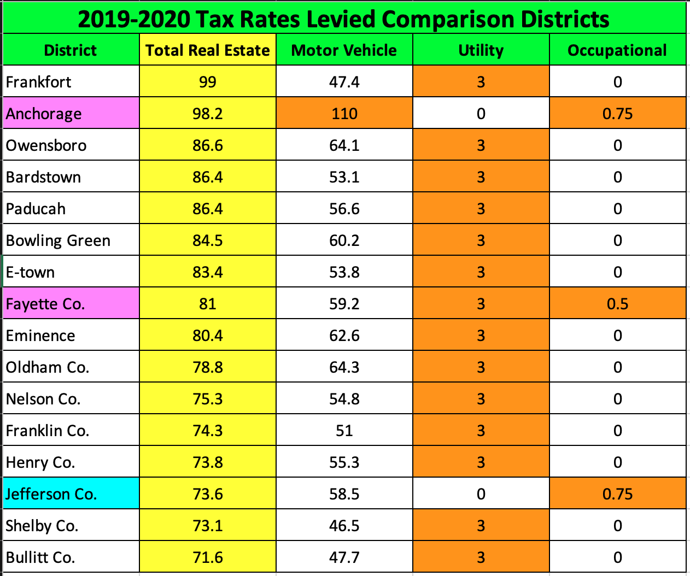
COMPARISONS TO OTHER DISTRICTS
(Kentucky Department of Education, 2020)

Slide 82
COMPARISONS TO OTHER DISTRICTS
Fayette County
Jefferson County
(Office of Educational Accountability, 2018, pp. 18, 184)

Slide 83
COMPARISONS TO OTHER DISTRICTS
JCPS has over one-fifth of all homeless students in Kentucky.
JCPS has one-third of all English learners in Kentucky.
(Office of Educational Accountability, 2018, pp. 184-186, 360-361)

Slide 84
COMPARISONS TO OTHER DISTRICTS
(Kentucky Department of Education, 2020)

Slide 85
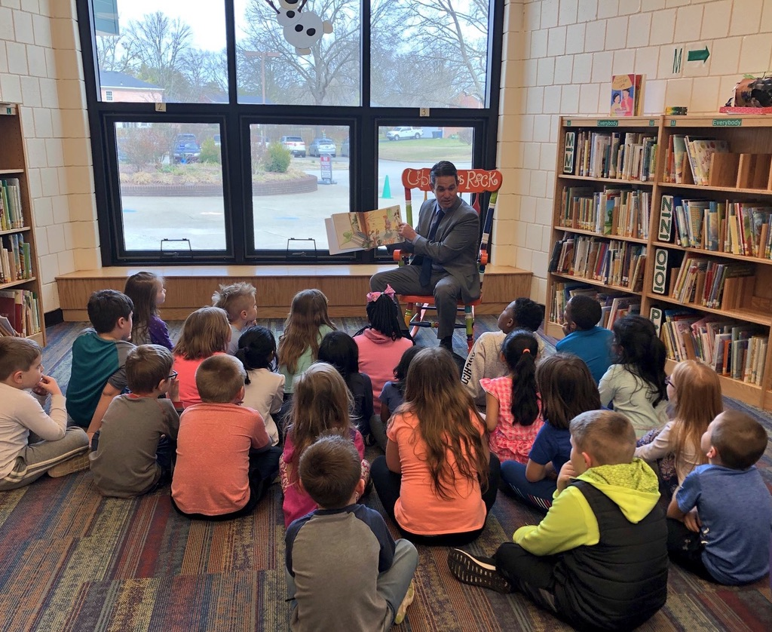
COMPARISONS TO OTHER DISTRICTS

Slide 86
6. COMMUNITY BENEFITS

Slide 87
COMMUNITY BENEFITS
“Studies show that the more formal education a person receives, the less likely he or she is to engage in crime, especially violent crime.”
“Studies provide compelling evidence that educational programs play a causal role in the reduction of crime.”
“The greatest impacts of graduation are associated with [reduced arrests for] murder, assault, and motor vehicle theft.”
(Education Law Center, 2011, pp. 14-15)

Slide 88
COMMUNITY BENEFITS
“The public bears a huge financial burden from crime. … The National Institute of Justice estimates that these costs total $450 billion annually” (Education Law Center, 2011, p. 13).
“The nation currently spends on average over $13,000 more annually per inmate then per student” (Education Law Center, 2011, p. 16).

Slide 89
COMMUNITY BENEFITS
“Children with incarcerated parents struggle more in school.”
“Kentucky has second largest share of children with a parent who has been incarcerated.”
(Kentucky Center for Economic Policy, 2020, p. 28)

Slide 90
COMMUNITY BENEFITS
“Graduating from high school … reduces dependence on public health programs by 60 percent, and cuts by six times the rate of alcohol abuse” (Education Law Center, 2011, p. 3).
“Average annual public health costs are $2,700 per dropout, $1,000 per high school graduate” (Education Law Center, 2011, p. 3).
“Health insurance premiums are inflated up to 10 percent just to cover the costs of the uninsured” (Education Law Center, 2011, p. 21).

Slide 91
COMMUNITY BENEFITS
“Research over many decades has documented the benefits of education for … economic growth.”
“The expansion of … education in the United States between 1915 and the late 1950s explains beyond any other factor ... the economic dominance of the United States in the 20th century.”
(Education Law Center, 2011, p. 10)

Slide 92
COMMUNITY BENEFITS
“Investing in public education is thus far more cost-effective … than paying for the social and economic consequences of under-funded, low-quality schools” (Education Law Center, 2011, p. 3).
“This internal rate of return is … larger than long-term returns to stocks” (National Bureau of Economic Research, 2015, p. 40).

Slide 93
7. RECOMMENDATION

Slide 94
RECOMMENDATION
Revenue Advisory Task Force (27 members)
8 representatives of community organizations
7 constituents
5 school funding experts
2 teacher representatives
2 state legislators
2 JCPS Board Members
1 business partner
Dr. Pollio attended all meeting
Five 90-minute meetings (Oct 10, Oct 28, Nov 11, Nov 25, Dec 9)
Presented to full JCPS Board of Education two times (Dec 10, Jan 28)

Slide 95
COMPARISONS TO OTHER DISTRICTS
(Kentucky Department of Education, 2020)

Slide 96
RECOMMENDATION
Our property tax rate is much lower than comparable districts.
We need the flexibility of general fund dollars to allocate resources to equity and improving student outcomes.
Facilities tax revenue has too many strings attached. People before property.
We get benefits of the facility tax by dedicating a portion to address the $1 billion of unmet facilities needs.

Slide 97
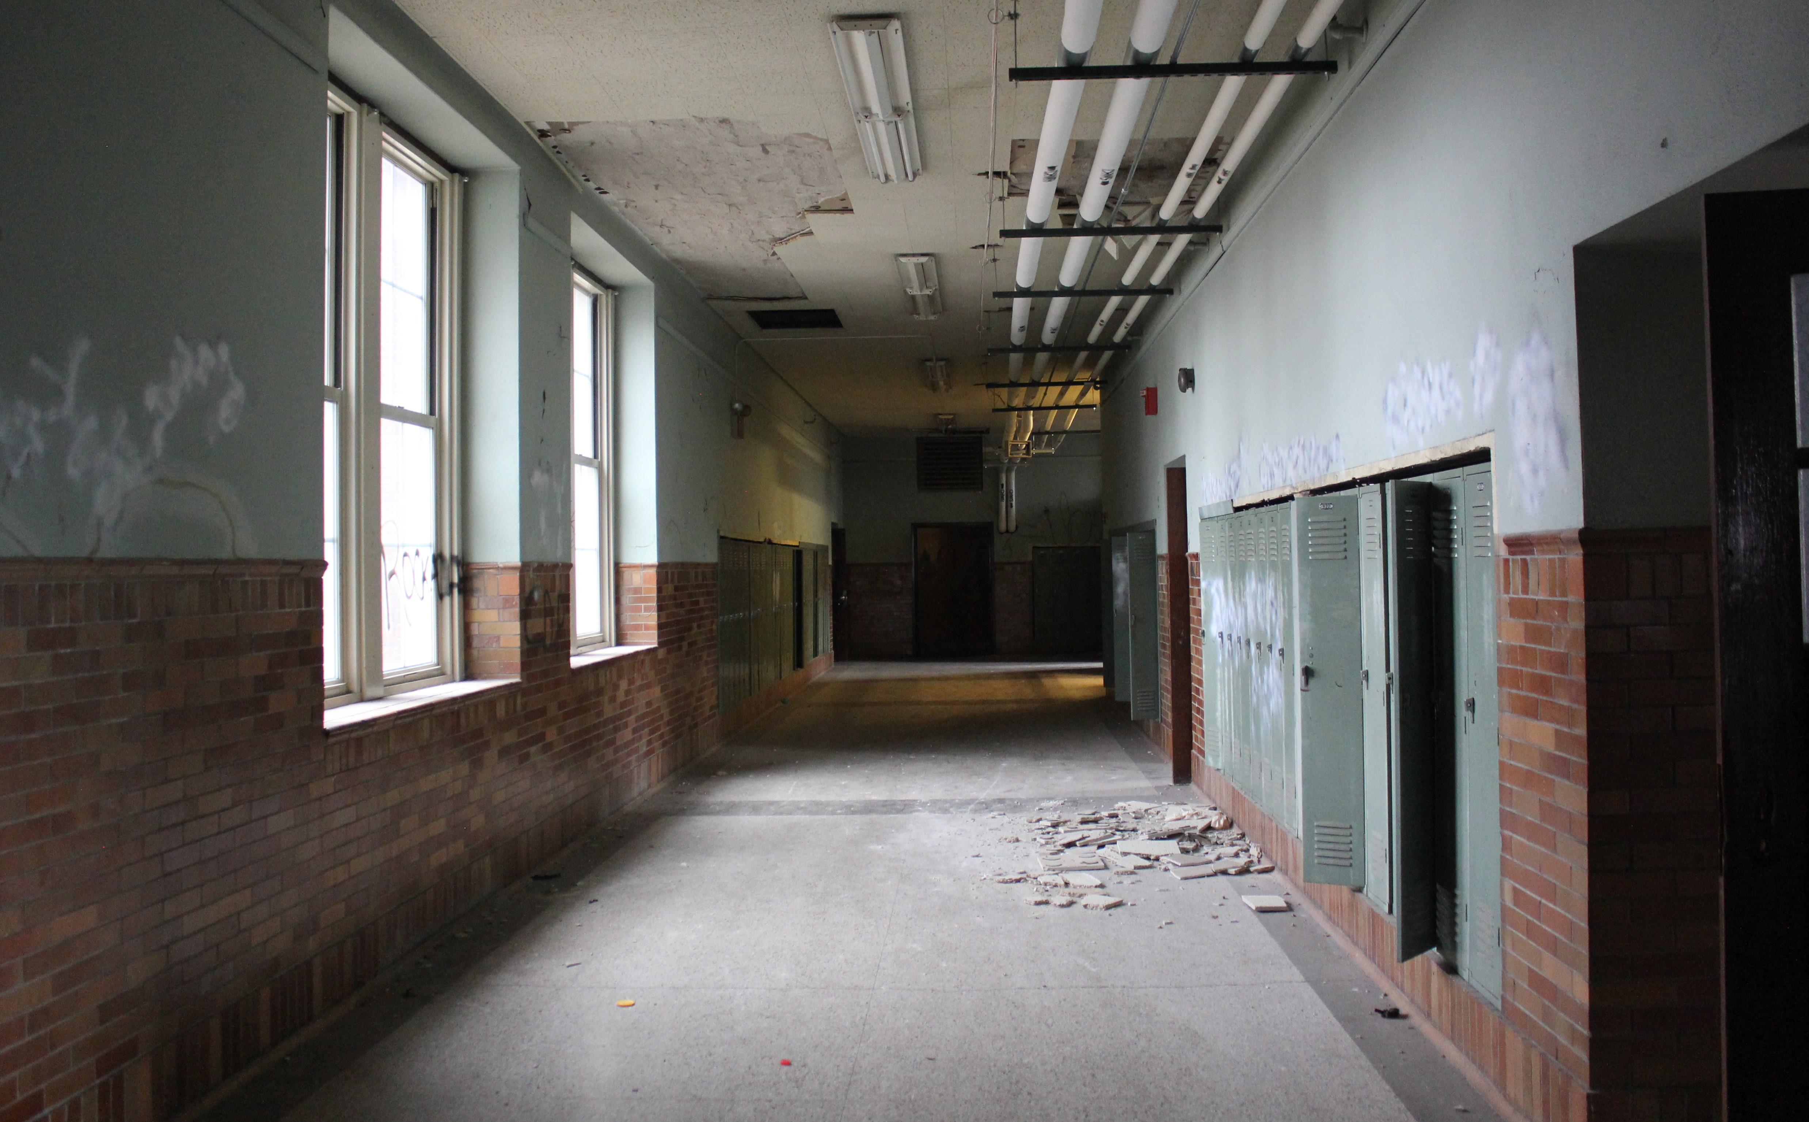
RECOMMENDATION
“Newest” JCPS high school built in 1968, over 50 years ago.
JCPS has 32 buildings at end of life at risk for being deemed unfit for students.

Slide 98
RECOMMENDATION

Slide 99
RECOMMENDATION

Slide 100
RECOMMENDATION

Slide 101
RECOMMENDATION

Slide 102
COMPARISONS TO OTHER DISTRICTS
(Kentucky Department of Education, 2020)

Slide 103
RECOMMENDATION
Directly responds to state audit criticism.
(Kentucky Department of Education, 2017, p. 8)

Slide 104
RECOMMENDATION
Built into the base and compounds year after year.
Provides additional resources in the future.
Recovers revenue lost due to poor decisions of former JCPS leaders.

Slide 105
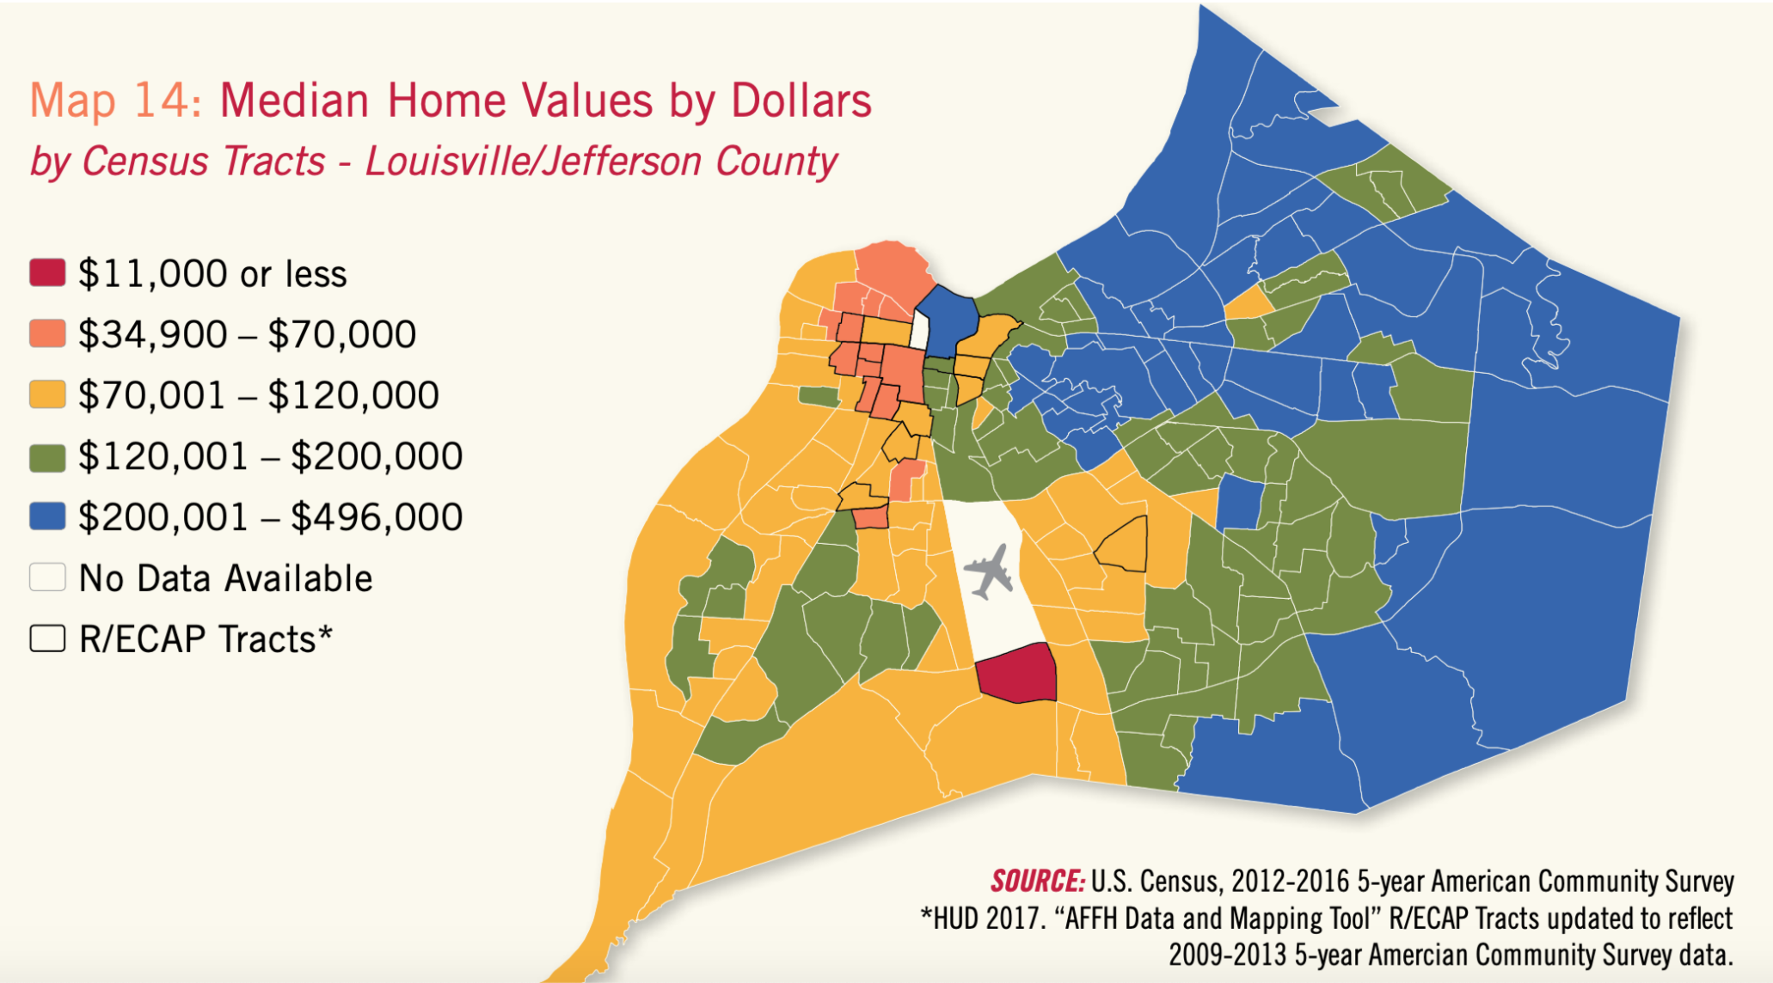
RECOMMENDATION
It is a fairly progressive funding source.
(Metropolitan Housing Coalition, 2018, p. 36)

Slide 106
RECOMMENDATION
Gives us a much better chance to significantly improve student outcomes, especially for students from low-income families, African American children, kids with disabilities, and English learners.

Slide 107
RECOMMENDATION
Process and Timeline
May 21 Board meeting and hearing (vote taken)
May 21–Jul 10 50-day period for collecting petition signatures
(35,615 signatures needed for voter referendum)
Jul 11–Aug 11 30-day period to validate petition signatures
Aug 11 Notice to County Clerk if referendum needed
Sep 1 JCPS Board hearing to finalize (if no referendum)
Nov 3 Voter referendum (if necessary)

Slide 108
COMPARISONS TO OTHER DISTRICTS
(Kentucky Department of Education, 2020)

Slide 109
RECOMMENDATION
Our kids need it.
Our kids deserve it.

Slide 110
REFERENCES CITED
Albert Shanker Institute. (2019). The adequacy and fairness of state school finance systems (1st ed.). New Brunswick, NJ: B.D. Baker, M. Di Carlo & M. Weber.
Alliance to Reclaim Our Schools. (2018). Confronting the education debt: We owe billions to black, brown and low-income students and their schools.
Baker, B. & Weber, M. (2016). Beyond the echo-chamber: State investments and student outcomes in U.S. elementary and secondary education. Journal of Education Finance, 42(1), 1-27.
Bailey, J, (2020, January 23). Tax cuts causing the worst revenue projections since consensus forecasting began. [web log] Retrieved from kypolicy.org/tax-cuts-causing-the-worst-revenue-projections-since-consensus-forecasting-began/
Barton, R. (2017). Kentucky among states with deepest education cuts since recession. Retrieved from wfpl.org/kentucky-among-states-with-deepest-education-cuts-since-recession/
Bryant, J. (2017). GOP war on learning continues in senate tax plan, state funding cuts. Retrieved from educationopportunitynetwork.org/gop-war-on-learning-continues-in-senate-tax-plan-state-funding-cuts/

Slide 111
REFERENCES CITED
Center on Budget and Policy Priorities. (2017). A punishing decade for school funding. Washington, DC: Leachman, M., Masterson, K., & Figueroa, E.
Dietrichson, J. Bøg, M., Filges, T., & Klint Jørgensen, A.M. (2017). Academic interventions for elementary and middle school students with low socioeconomic status: A systematic review and meta-analysis. Review of Educational Research, 87(2), 243-282.
Economic Policy Institute. (2018). The teacher shortage is real, large and growing worse than we thought: The first report in “The perfect storm in the teacher labor market’ series. Washington, DC: E. García and E. Weiss.
Economic Policy Institute. (2019). The teacher weekly wage penalty hit 21.4 percent in 2018, a record high: Trends in the teacher wage and compensation penalties through 2018. Washington, DC: S. Allegretto & L. Mishel.
Education Law Center. (2011). Pennsylvania’s best investment: The social and economic benefits of public education. Philadelphia, PA: Mitra, D.
Educational Testing Service. (2016). Mind the gap: 20 years of progress and retrenchment in school funding and achievement gaps. Princeton, NJ: B.D. Baker, D. Farrie, & D.G. Sciarra.

Slide 112
REFERENCES CITED
Greenwald, R., Hedges, L.V., & Laine, R.D. (1996). The effect of school resources on student achievement. Review of Educational Research, 66(3), 361-396.
Institute on Taxation and Economic Policy. (2018). Kentucky: Who pays? (6th ed.). Washington, DC: Wiehe, et al.
Kentucky Center for Economic Policy. (2019). Research briefing data resources. Frankfort, KY.
Kentucky Center for Economic Policy. (2020). What does Kentucky value? A preview of the 2020-2022 budget of the commonwealth. Frankfort, KY.
Kentucky Department of Education. (2013). Nickel facts. Retrieved from education.ky.gov/districts/SEEK/.../Nickel%20Facts%207%2008%2019.docx
Kentucky Department of Education. (2017). Jefferson County management audit report per KRS 158.785 (attachment 8). Frankfort, KY: Lewis, W.
Kentucky Department of Education. (2020). SEEK taxes. Retrieved from education.ky.gov/districts/SEEK/Pages/Taxes.aspx

Slide 113
REFERENCES CITED
Kentucky School Boards Association. (2017). Interim advocacy newsletter, November.
Learning Policy Institute. (2016a). A coming crisis in teaching: Teacher supply, demand, and shortages in the U.S. Palo Alto, CA: L. Sutcher, & D. Carver-Thomas.
Learning Policy Institute. (2016b). Addressing California’s emerging teacher shortage: An analysis of sources and solutions. Palo, Alto, CA: L. Darling-Hammond, R. Furger, P. Shields, & L. Sutcher.
Learning Policy Institute. (2017). How money matters for schools. Palo Alto, CA: B.D. Baker.
Loeb, S. & Page, M.E. (2000). Examining the link between teacher wages and student outcomes: The importance of alternative labor market opportunities and non-pecuniary variation. The Review of Economics and Statistics, 82(3), 393-408.
Metropolitan Housing Coalition. (2018). Involuntary displacement, Louisville: KY: Kinahan, K., Heberle, L., & Sizemore, S.

Slide 114
REFERENCES CITED
National Bureau of Economic Research. (2014). The effects of school finance reforms on the distribution of spending, academic achievement, and adult outcomes. Cambridge, MA: C. Kirabo Jackson, R. Johnson, & C. Persico.
National Bureau of Economic Research. (2015). The effects of school spending on educational and economic outcomes: Evidence from school finance reforms. Cambridge, MA: C. Kirabo Jackson, R.C. Johnson, & C. Persico.
Office of Educational Accountability. (2018). Kentucky district data profiles school year 2017. Report No. 453. Frankfort, KY.
Shoulta, J. (2019). Greater tax flexibility strengthens local decision making. Kentucky School Advocate, February.
Spalding, A. (2018, August 9). As kids head back to school, districts have even fewer resources than previous years. [web log] Retrieved from kypolicy.org/as-kids-head-back-to-school-districts-have-even-fewer-resources-than-previous-years/
Spalding, A. (2019, August 14). Kentucky kids head back to school amid historically deep funding cuts. [web log] Retrieved from kypolicy.org/kentucky-kids-head-back-to-school-amid-historically-deep-funding-cuts/

Slide 115
REFERENCES CITED
Wenglinsky, H. (1997). How money matters: The effect of school district spending on academic achievement. Sociology of Education, 70(3), 221-237.

Slide 116
8. DISCUSSION
Questions and Comments?

